Slide 1






LIFE ORGANISER
BY: Erifeoluwa Jamgbadi

Slide 2




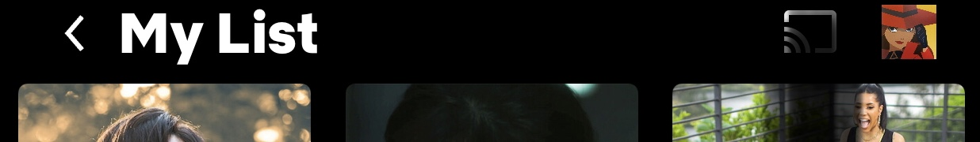
Introduction
Movies
Youtube
Music
Reading
TV Series

Slide 3

LIFE ORGANISER

Slide 4
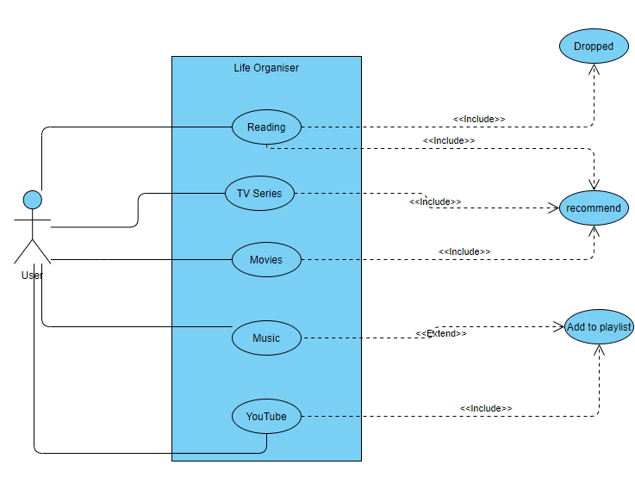
App Use Case

Slide 5
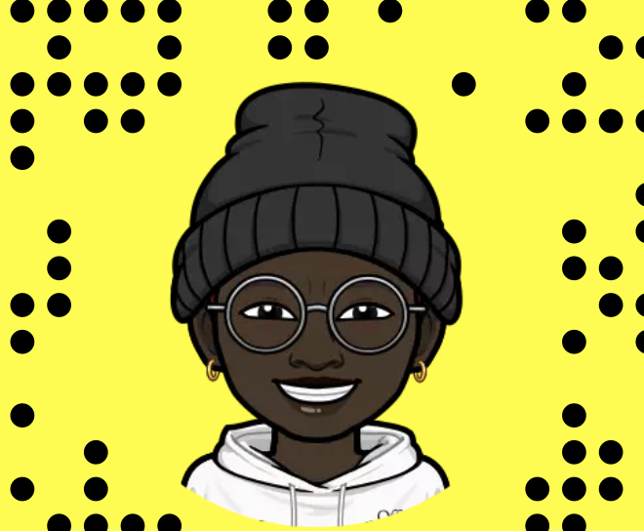
Who are the target audience? The Users?
Used myself for data collection
Wants to be organize
Have the hobbies all in one place
People who have similar hobbies to me

Slide 6
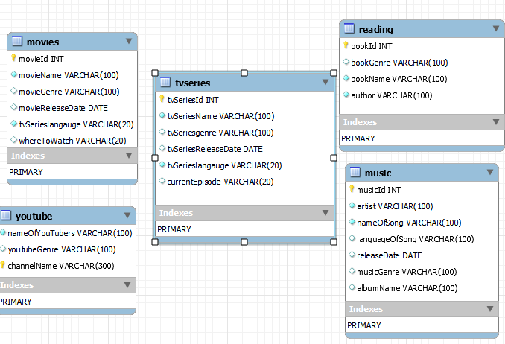
Overview of Schema
* All the tables from my database. I only had primary keys and no foreign keys, since the tables are not related to each other

Slide 7
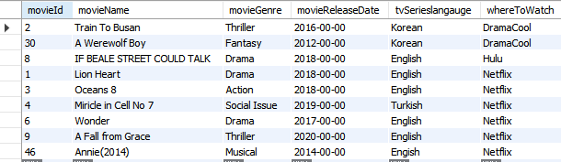
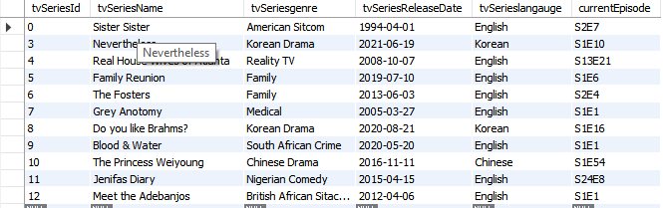
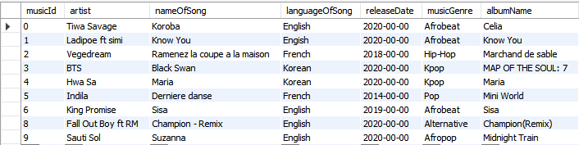
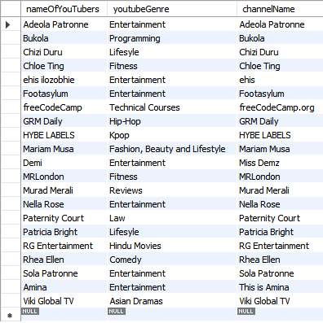
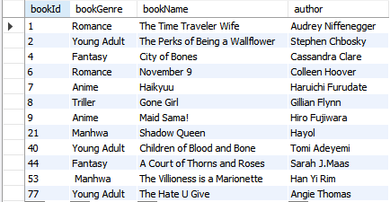
Query -> Features
Basic Feature : Can find all the list of things

Slide 8
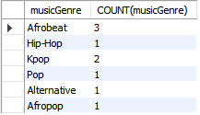

Query -> Features
2. Basic Feature : A feature to analysis what type of movies the user watches, so if it was ever developed, recommendations can be made

Slide 9


Query -> Features
3. Basic Feature : Find courses to develop myself based on accounts I watch on YouTube. I study computer science, so the only accounts, where I can further develop myself based on the data provided of what I watch on YouTube is freeCodeCamp

Slide 10
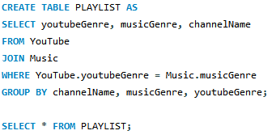
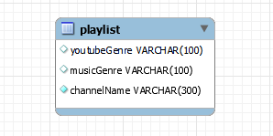

Query -> Features
4. Intermediate Feature : To add music listened to from YouTube to my Spotify playlist with the same genre

Slide 11
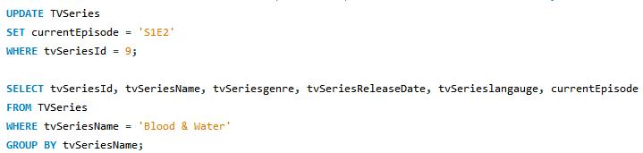
Query -> Features
5. Intermediate Feature : This is so the user will be able to update the episode of the tv series, when they have completed an episode. So this example, the user finished ep 1 and is then on ep 2, so they then change their list to show this

Slide 12
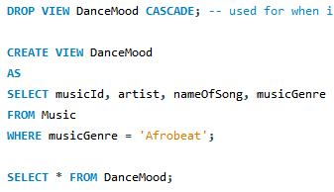

Query -> Features
6. Advance Feature : Depending on the users mood, it will play songs that the user can dance to, for example, I like to hear afrobeat when I'm happy because it makes me more happy

Slide 13
Query -> Features
If the user is currently watching, its going to add them to a table heading called “wantToWatch” . Was going to add a feature to TVSeries, if the ep is S1E1, then put as want to watch table

Slide 14


